Slide 1


Slide 2

Agenda
Hybrid repositories
Workflow and automation
Complimenting O365

Slide 3


Slide 4







Email inbox
Line of business applications
Where do your files live?
local drives
network shares

Slide 5
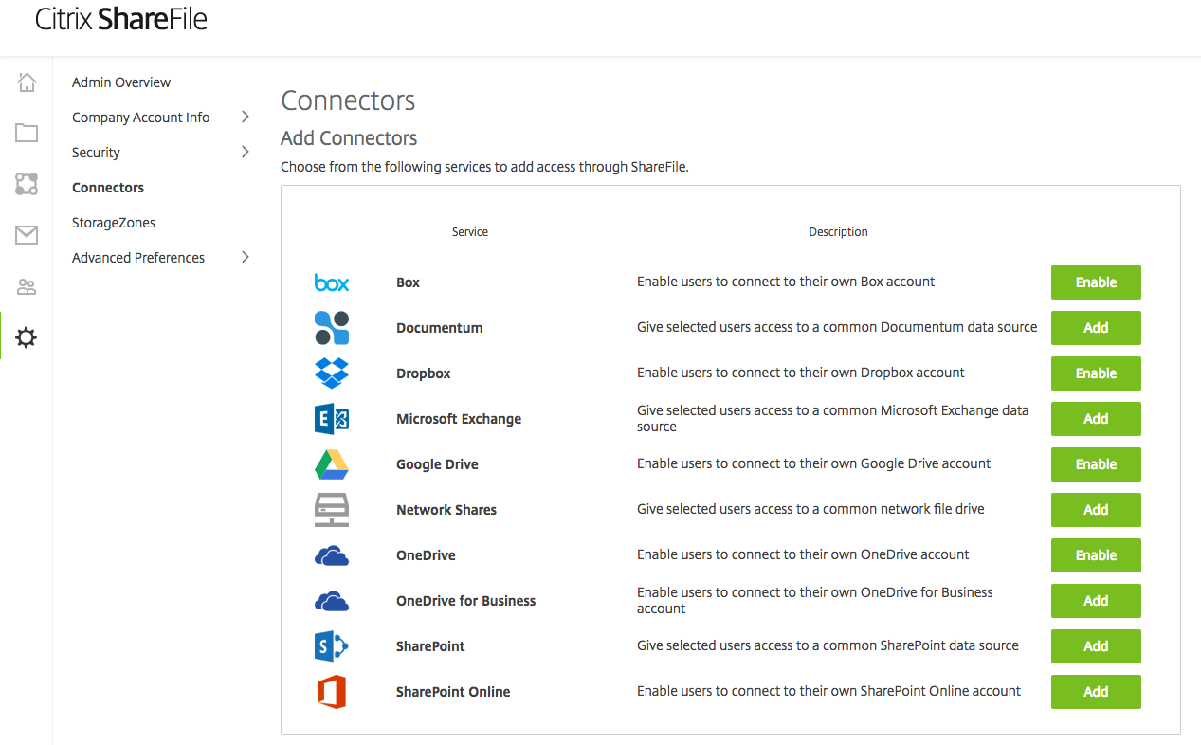
Easily manage multiple Data Sources

Slide 6

DEMO

Slide 7
Extending Office 365:
Secure Collaboration
Use ShareFile to create and complete document workflows and electronic signatures.

Slide 8
Office 365 co-authoring
Rich Integration with Office 365
Preview and Edit Office files directly from within the ShareFile Web Application.
Rich file interaction without the need to have Microsoft Office installed locally
Extend the value of Office 365

Slide 9

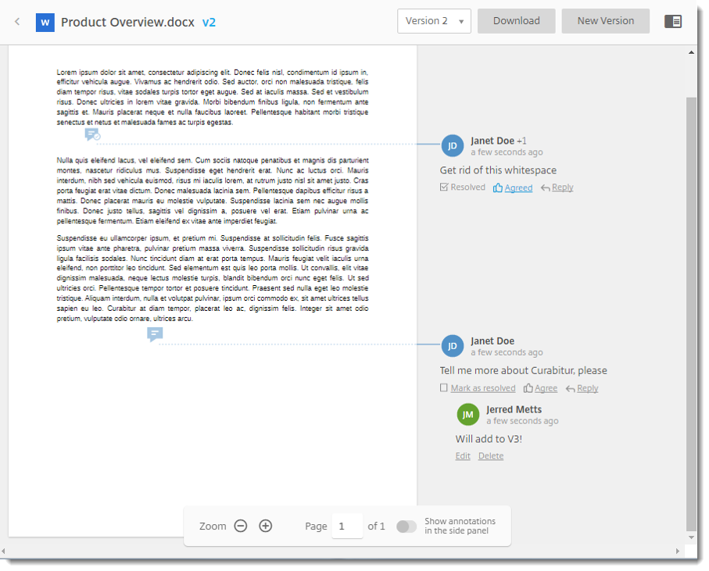
Feedback and Approval Workflows
Extend collaboration features of Office 365
Request or provide feedback to/from colleagues, business partners, and clients within a shared document or file.
Simple and secure version control, and streamlined approval management in an all-in-one structured workspace.
Not available with OneDrive
Extend collaboration in Office 365

Slide 10

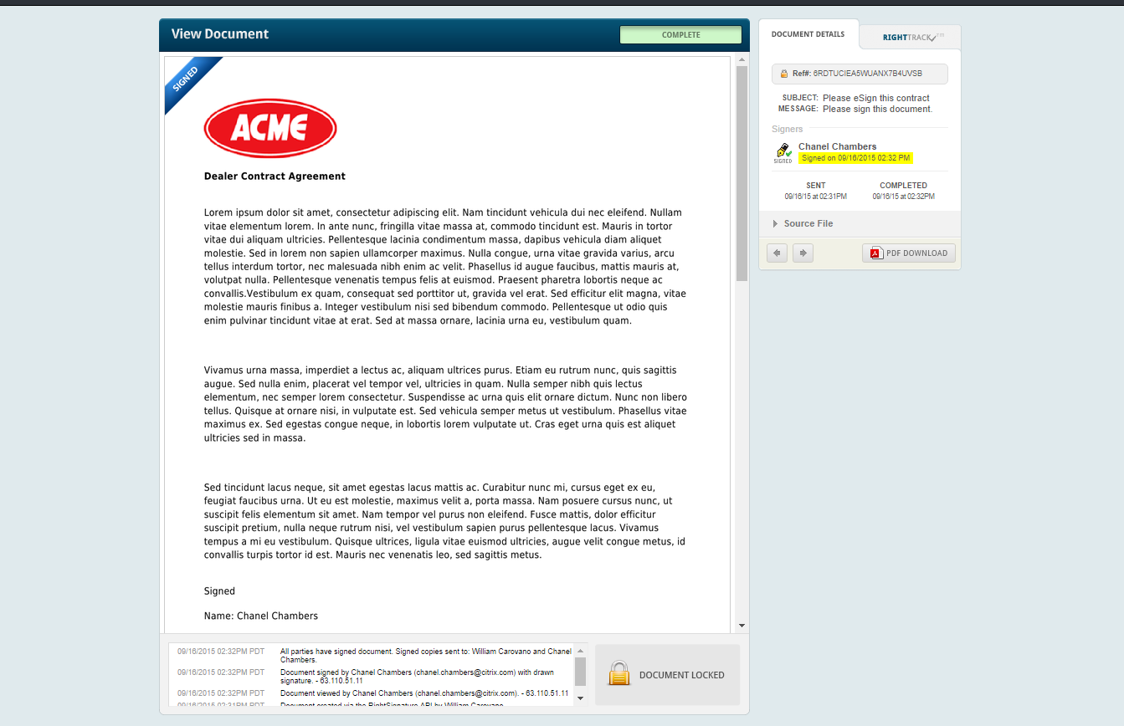
Electronic Signatures
Rich Integration with Office 365
Users can automatically send documents for feedback, approval, and electronic signature directly from ShareFile; no need for bulky email attachments.
Not available with OneDrive
Rich Integration with Office 365

Slide 11

Extending Office 365:
Secure Data Source Choice
StorageZone Connectors allow users to access files in Office 365, Azure, SharePoint, and network shares from a single app

Slide 12
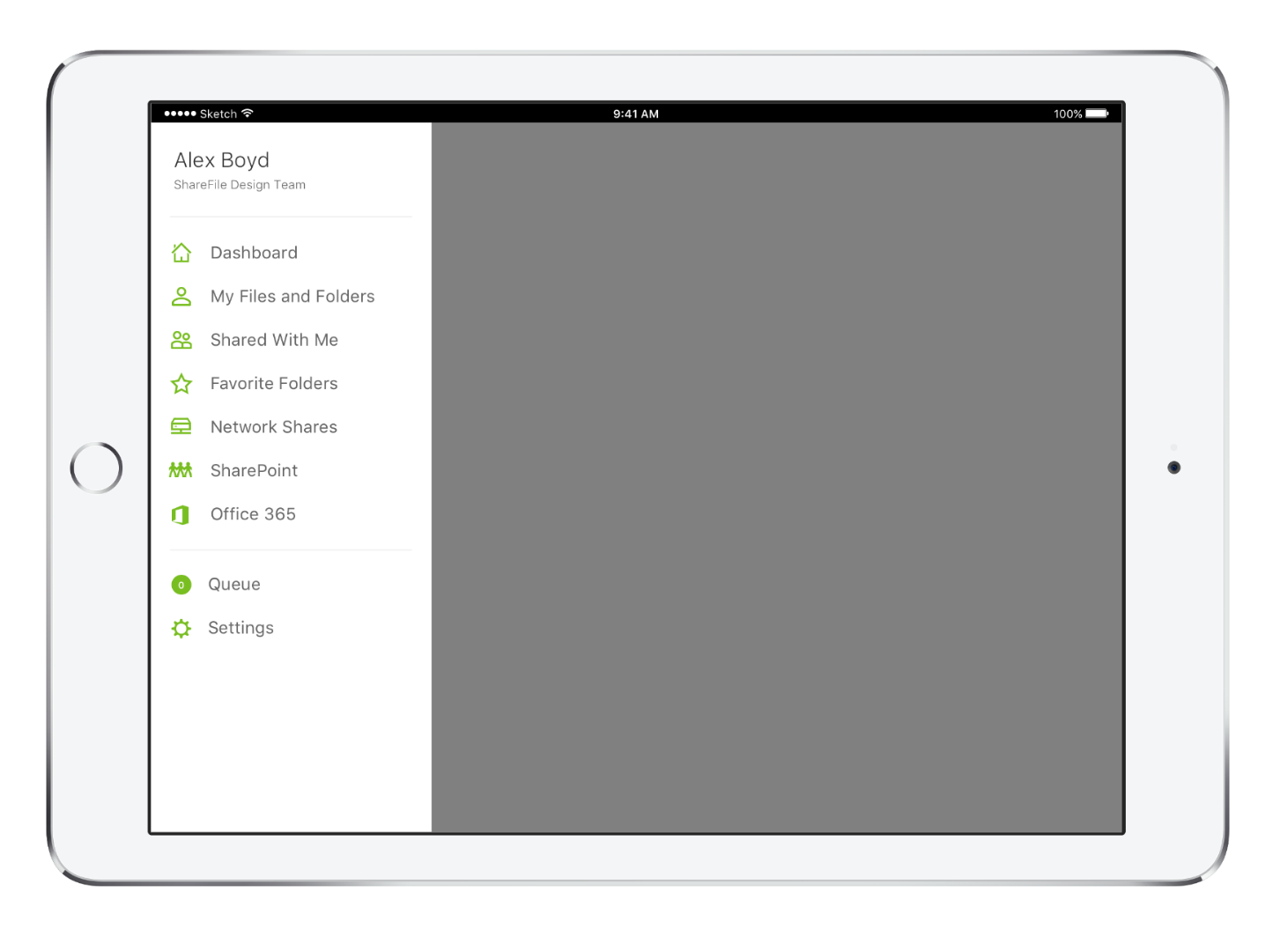
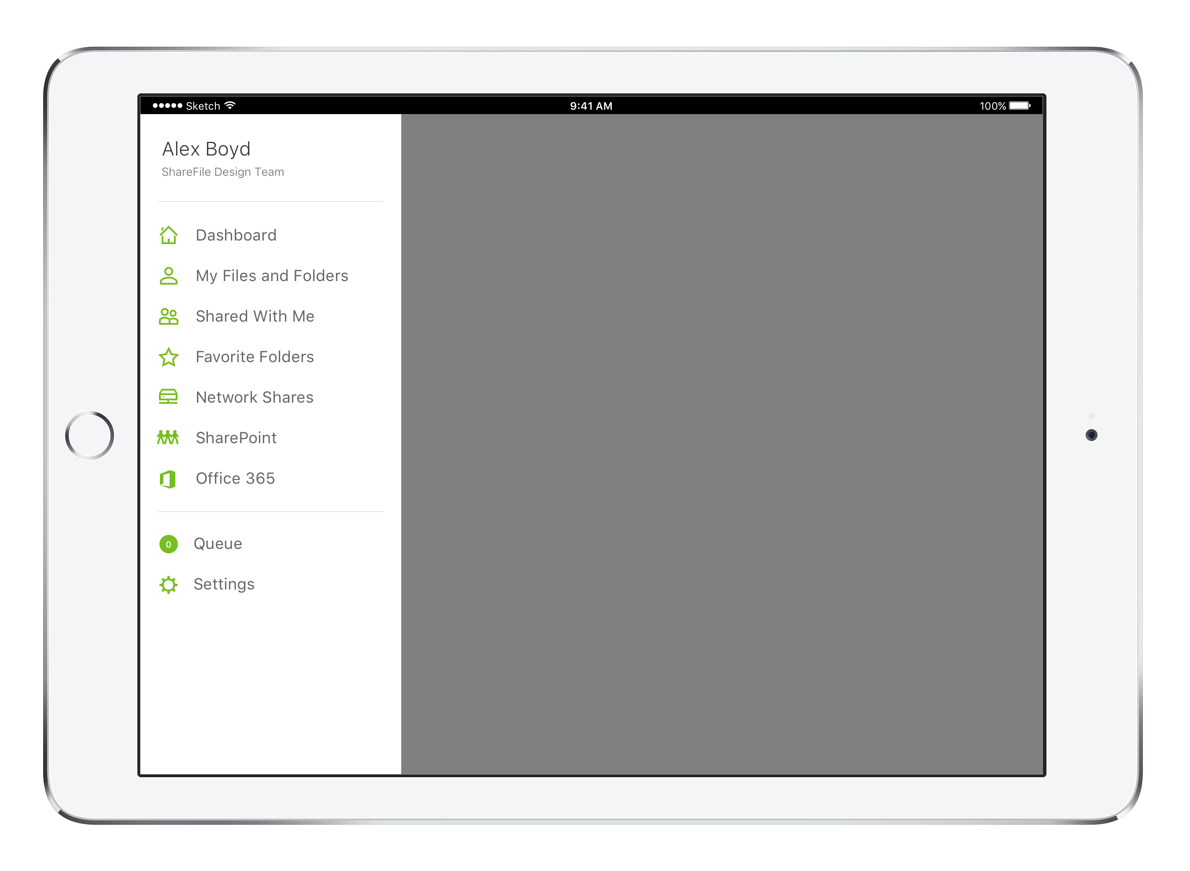
Connectors
Increase productivity within the O365 experience
Documents live in their native repository
View, edit, share*, use offline
No changes to permissions & auditing
Windows, iOS, Android, Web
Not available with OneDrive
Increase productivity in O365

Slide 13

Extending Office 365:
Improved Productivity and Virtualization Support
Use ShareFile to share files securely with anyone on any device.

Slide 14
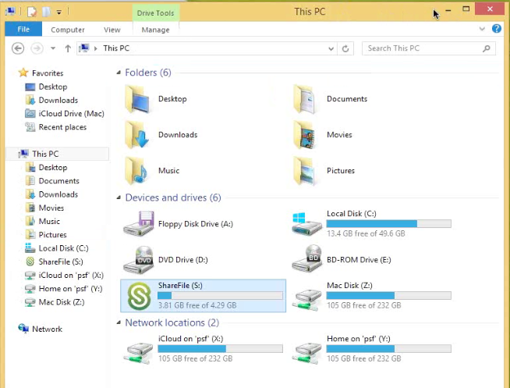
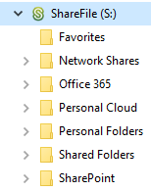
Drive Mapper
Access OneDrive for Business & SharePoint online within hosted VDI
Policy-controlled on-demand access ideal for XenApp / XenDesktop farms
Access network drives, OneDrive, SharePoint, and other cloud repositories
Users stay productive in the native Windows experience
Not available with OneDrive
Stay productive in O365 environment

Slide 15

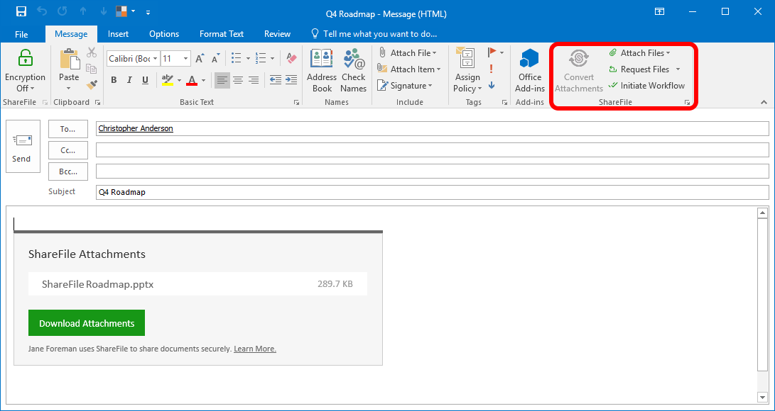
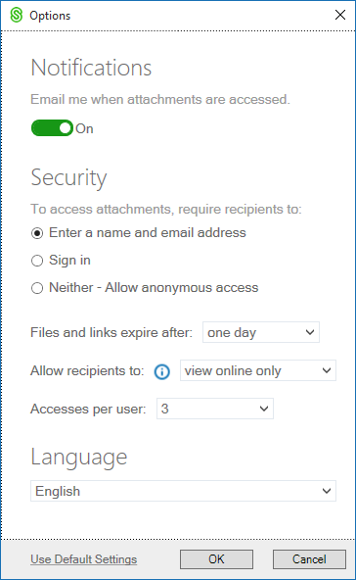
Outlook Plug-In
Boost OneDrive Efficiency
Overcome file size restrictions
Set link expiration policies
Initiate Workflows
Request large files
Request login
Track downloads
Not available with OneDrive
Customizable Security
Attachments converted to links
Boost OneDrive Efficiency

Slide 16
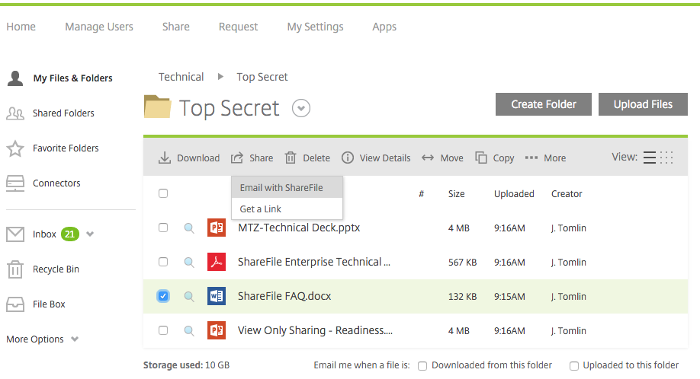
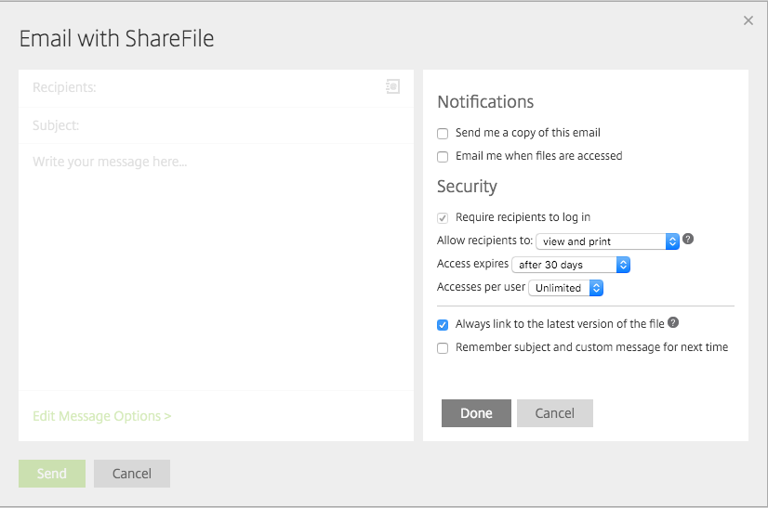
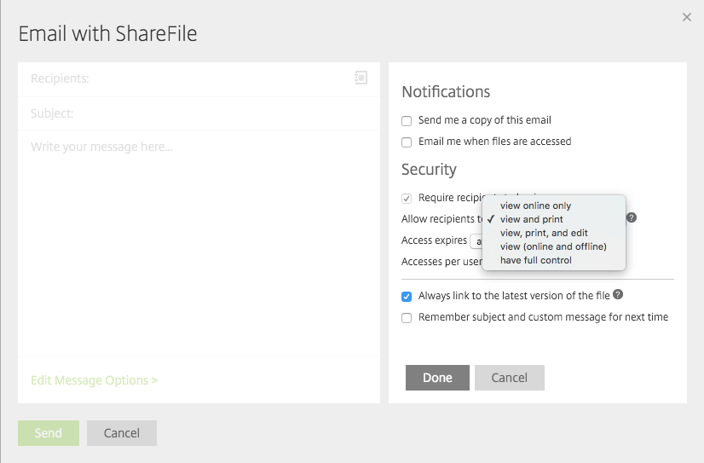
Information Rights Management
Advanced Security Features
ShareFile controls for authentication & authorization apply within the ShareFile system
Once a file is downloaded, control over further distribution of that file is lost
Additional fee with O365
Advanced Security Features

Slide 17
Resources
Slides and demos from the conference will be available at github.com/nordicinfrastructureconference/2018 (bit.ly/2y7JhA3)

